Slide 1

SMART SECURITY SYSTEM USING IMAGE RECOGNITION
PROJECT BY :
ARPITA PRAKASH HEGDE
NEHA PAWAR K R
NIDHI S JAIN
NIKITA B N
YASHASWINI BANDLOOR V

Slide 2

INTRODUCTION
The Smart security system using image recognition service in real time would help the home based security system to track the persons coming into the house and unlocking the door. Hereby the system would be accessed by using the image recognition service that uses opencv in which the images are trained in different classes labeled with the names of the family members and not only them they can train the images of their relatives and cousins with which we can give the access to unlock their door.

Slide 3
PURPOSE
By using Smart Security System Using Image Recognition we can secure home premises from the invaders and also capture the suspected people who are not authorized to move inside the house. And also for example, if a person is not at home and forgot keeping the keys for the housemates, they can give their facial image standing in front of camera in which the model would process the image, tally it with the reference images and then give the access to the housemates which could not make them wait in front of the door.

Slide 4
PROPOSED SYSTEM
The Smart Security System using Image Recognition uses Computer Vision (OpenCV). OpenCV uses a type of face detector called a Haar Cascade classifier. Given an image, which can come from a file or from live video, the face detector examines each image location and classifies it as "Face" or "Not Face." Classification assumes a fixed scale for the face, say 50x50 pixels. Since faces in an image might be smaller or larger than this, the classifier runs over the image several times, to search for faces across a range of scales. A standard camera captures the image to spot the person. It’s a prototype that identifies the visitor. If the door recognizes the visitor, the door is going to be unlocked. If they are not identified the door will remain firmly locked. This system talks about four features: security, safety, control and monitoring to home automation. Thus, when an unauthenticated user tries to log in, a message is sent to the authorized person.

Slide 5
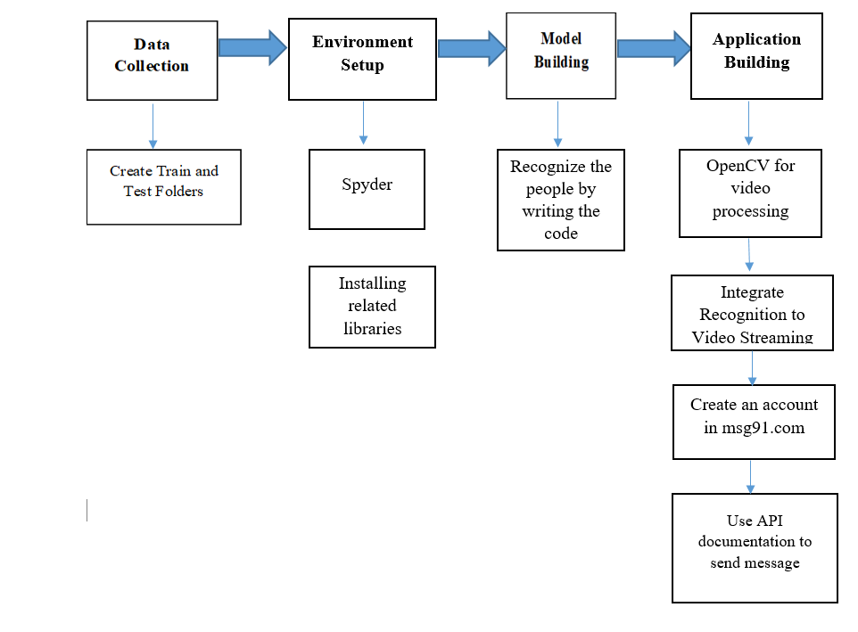
BLOCK DIAGRAM

Slide 6
RESULT
A standard camera captures the image to recognize the face of the person using Haar Cascade classifier which is a service of OpenCV. If it recognizes the visitor, it allows the person and the door is going to be unlocked. If the face is not identified, it does not allow the person inside the house and the door will remain locked. Thus, when an unauthenticated user tries to log in, a message is sent to the authorized person.

Slide 7
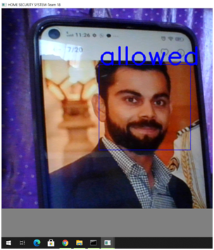
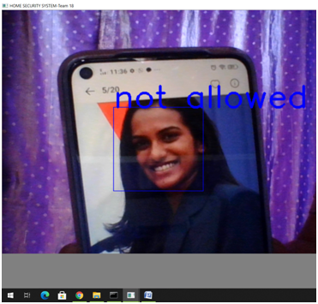
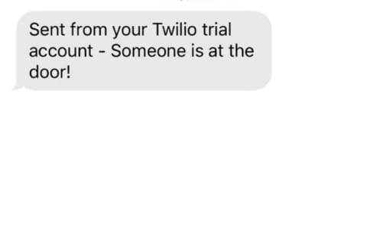
When an authorized face is detected
When an unauthorized face is detected
Message sent to the authorized person when an unauthorized face is detected

Slide 8
THANK YOU

